Slide 1

IT5002
Computer Systems and Applications
Lecture 14
Inter-Process Communication
colintan@nus.edu.sg

Slide 2
Learning Objectives
By the end of this lecture you will be able to:
Understand what race conditions are, and why they are bad.
Understand the various ways to prevent race conditions.
Understand how to pass messages between processes.
Some example code are taken from ArdOS, the Arduino Operating System.
Simple kernel code.
Obtainable from http://www.bitbucket.org/ctank/ardos-ide

Slide 3
Introduction
In the lecture we looked at how multiple processes can run on a single CPU.
In real-world applications, there are “dependencies” between processs.
Process B cannot proceed because it is waiting for Process A’s result.
Process B and Process A update the same shared variable, which can result in errors.
…

Slide 4
Introduction
If both Process A and Process B are allowed to run freely, errors will occur.
Process B proceeds before Process A completes, resulting in B using stale results.
Process A and B update a variable at the same time, causing one process to over-write the results of the other process.
Etc.
Some form of coordination is therefore required!
Material from this course comes from different places.
Some books use “process” and some use “task”.
Just remember that they mean the same thing.

Slide 5
Race conditions and critical sections
Inter-Process Communications

Slide 6
Race Conditions
Race conditions occur when two or more processes attempt to access shared storage.
This causes the final outcome to depend on who runs first.
“Shared storage” can mean:
Global variables.
Memory locations.
Hardware registers.
- This refers to configuration registers rather than CPU registers.
Files.
To understand race conditions, we will consider the example of a queue in a print spooler.

Slide 7
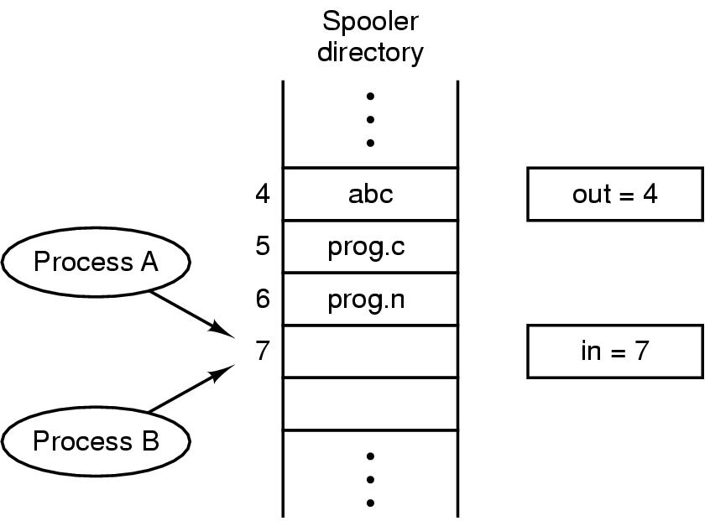
Race Conditions
A process that wants to print enters the name of the file into a print directory.
A print daemon (printd) periodically checks the directory, prints out the next file and removes its entry.
Two variables keep track of this queue:
IN: Next available slot.
OUT: Next file for printing.

Slide 8
Race Conditions
The following can happen:
Process A reads IN as 7 and stores it in a local variable next.
The OS pre-empts A and starts B.
B reads IN as 7 and stores it in a local variable next.
B inserts its file into slot 7 and updates IN to 8.
B is pre-empted and A restarts.
A still thinks slot 7 is available and inserts its file there, overwriting B’s file, then updates IN to 8.
The daemon is unaware of the mistake, and B never gets a printout. ☹

Slide 9
Critical Sections
To prevent race conditions, we must prevent two processes from reading/writing shared resources at the same time.
This is known as a “mutual exclusion”, shortened to “mutex”.
Conceptually, a RUNNING process is always in one of two possible states:
It is performing local computation. This does not involve global storage, hence to race condition is possible.
It is reading/updating global variables. This can lead to race conditions.
When a RUNNING process is in the second state, it is within its “critical section”.

Slide 10
Critical Sections
To prevent race conditions, 4 rules must be followed:
No two processes can simultaneously be in their critical section.
No assumptions may be made about speeds or # of CPUs.
Note: We can relax this assumption for most embedded systems since they have single CPUs.
May apply to systems using multicore microcontrollers.
No process outside of its critical section can block other processes.
No process should wait forever to enter its critical section.

Slide 11
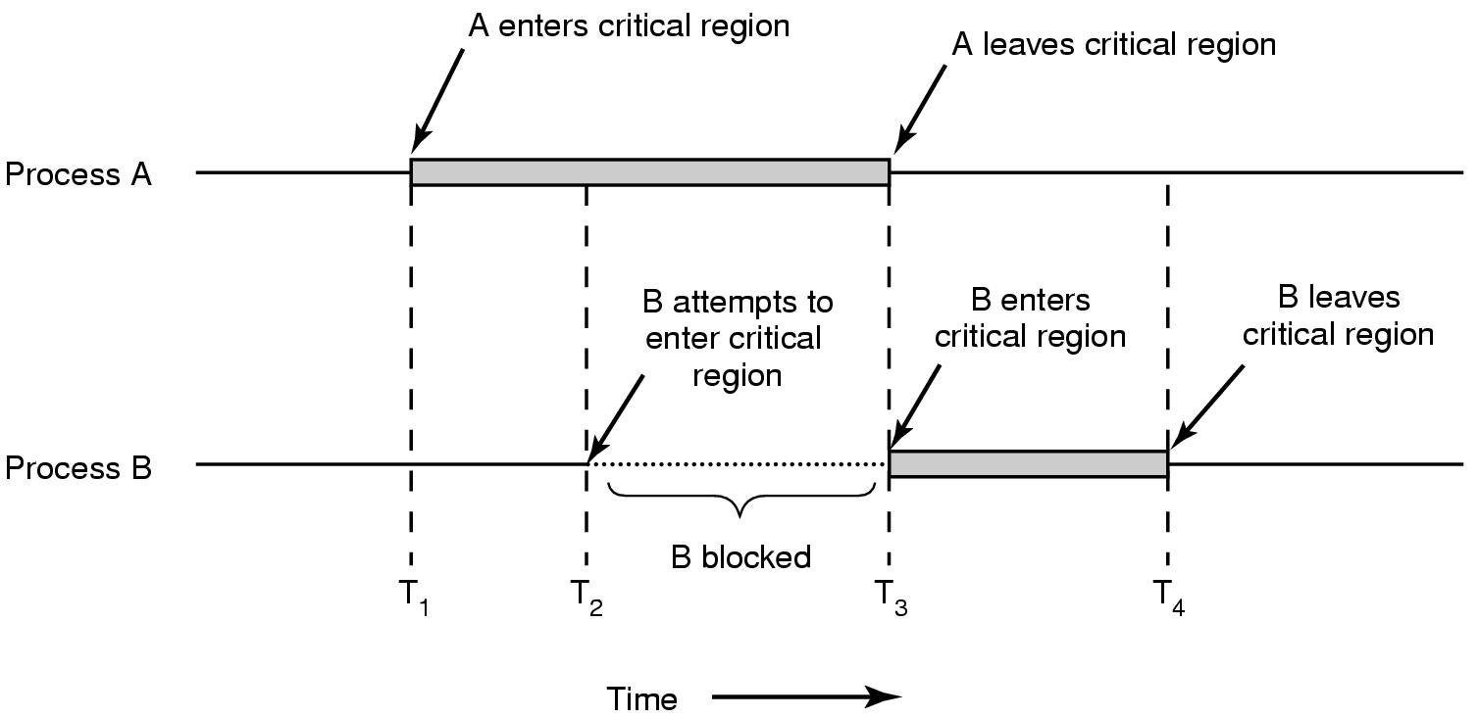
Critical Sections
In an ideal state, this is how mutual exclusion works:

Slide 12
Implementing mutual exclusion
Inter-Process Communications

Slide 13
Implementing Mutual Exclusion
There are several ways of implementing mutexes, each with their own + and – points:
Disabling interrupts.
Lock variables.
Strict alternation.
Perterson’s Solution.
Test and set lock.
Sleep/Wakeup

Slide 14
Implementing Mutual Exclusion Disabling Interrupts
Disabling Interrupts.
This works because:
Time-slicing depends on a timer interrupt. If this is disable, the scheduler is never activated to switch to another process.
Similarly, processes that are blocked pending an event (e.g. arrival of data from the network), depend on an interrupt to tell the scheduler that the event has taken place.
Therefore disabling interrupts will prevent other processes from starting up and entering their critical sections.

Slide 15
Implementing Mutual Exclusion Disabling Interrupts
Disabling Interrupts.
There are several problems with this approach:
Carelessly disabling interrupts can cause the entire system to grind to a halt.
This only works on single-processor, single core systems. Violates Rule 2.
This approach is used in ArdOS since the supported boards are all single-processor and single-core.

Slide 16
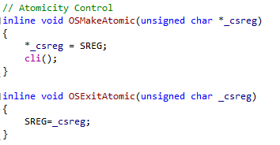
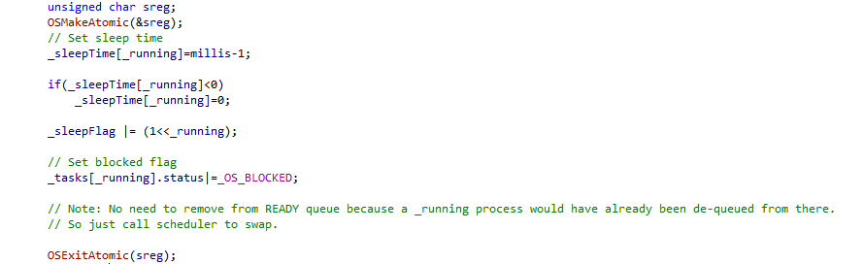
Implementing Mutual Exclusion Disabling Interrupts
ArdOS Implementation:
Call to OSMakeAtomic and OSExitAtomic

Slide 17
Implementing Mutual Exclusion Lock Variables
Using Lock Variables.
A single global variable “lock” is initially 1.
Process A reads this variable and sets it to 0, and enters its critical section.
Process B reads “lock” and sees it’s a 0. It doesn’t enter its critical section and waits until “lock” is 1.
Process A finishes and sets “lock” to 1, allowing B to enter.

Slide 18
Implementing Mutual Exclusion Lock Variables
This approach obviously doesn’t work!!
Process A reads in “lock” and sees a “1”. It gets pre-empted and Process B runs.
Process B reads in “lock”, sees a “1”, sets it to 0 and enters its critical section.
Before B leaves, A is re-started, and enters the critical section.
Now >1 process is in the critical section!
PROBLEM: There’s a race condition on “lock” itself!

Slide 19
Test and Set Lock
Many microprocessors have an instruction that looks like this:
TSL reg, lock ; lock is a variable in memory
How this works:
CPU locks the address and data buses, and reads “lock” from memory.
The locked address and data buses will block accesses from all other CPUs.
The current value is written into register “reg”.
A “1” (or sometimes “0”) value is written to “lock”.
CPU unlocks the address and data buses.
The TSL is “atomic”.
This means that NOTHING can interrupt execution of this instruction.
This is guaranteed in hardware.

Slide 20
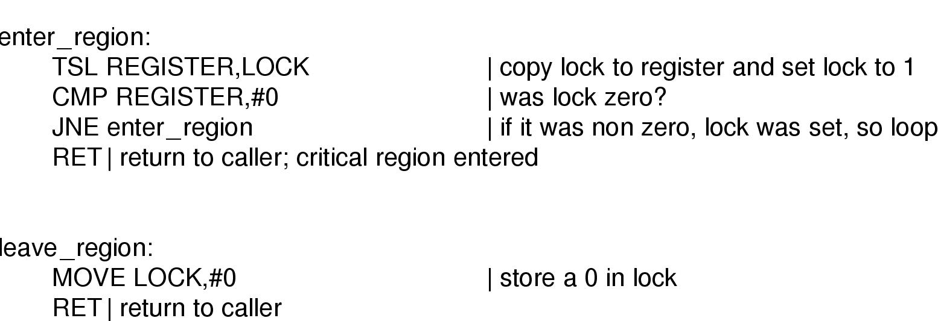
Test and Set Lock
The TSL instruction is used as follows:

Slide 21
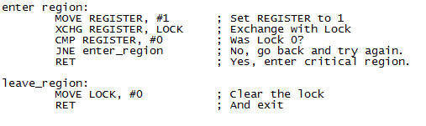
Test and Set Lock
An alternative is the XCHG instruction, used on Intel machines.
Swaps contents of “lock” and “reg” instead of just writing “1” to lock.

Slide 22
Deadlock
Busy-wait approaches like TSL/XCHG have a problem called “deadlock”.
Consider two processes H and L, and a scheduler rule that says that H is always run when it is READY. Suppose L is currently in the critical region.
H becomes ready, and L is pre-empted.
H tries to obtain a lock, but cannot because L is in the critical region.
H loops forever, and CPU control never gets handed to L.
As a result L never releases the lock.
Note: The book calls this a “priority inversion”, which is incorrect.

Slide 23
Sleep/Wake
One solution to this problem is through the use of “Sleep/Wake” functions.
When a process finds that a lock has been set (i.e. another process in the critical section), it calls “sleep” and is put into the blocked state.
When the other process exits the critical section and clears the lock, it can call “wake” which moves the blocked process into the READY queue for eventual execution.
While this sounds like an ideal solution, it can create a problem called the “producer-consumer problem”.

Slide 24
The producer/consumer problem
Inter-Process Communications

Slide 25
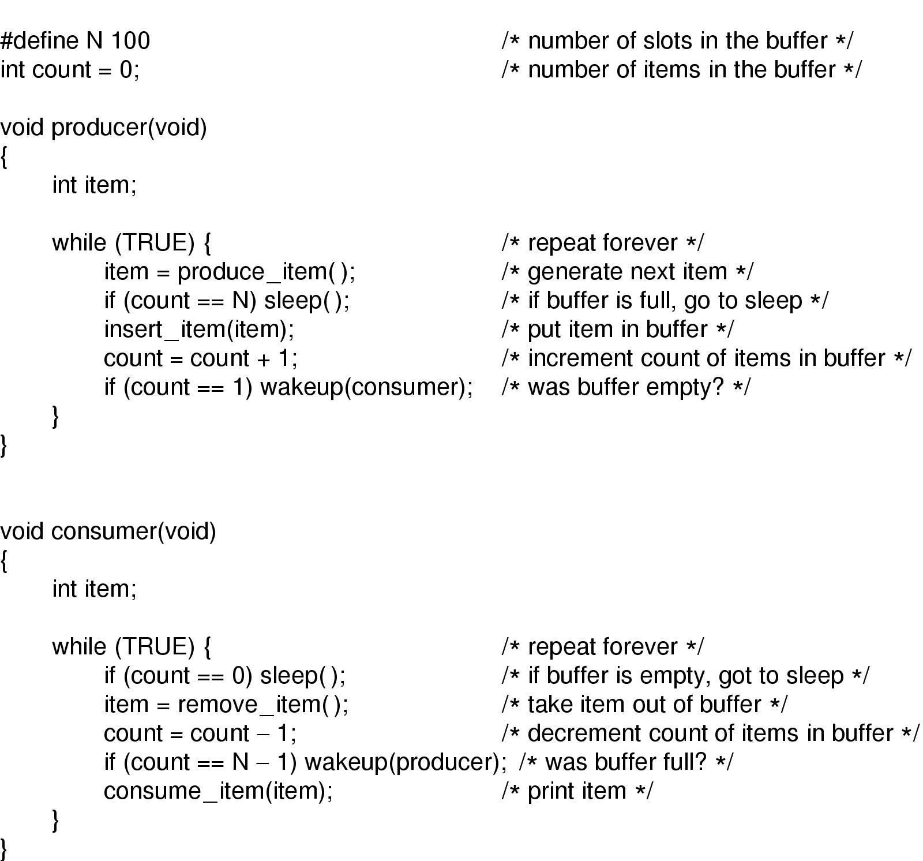
The Producer/Consumer problem

Slide 26
The Producer/Consumer problem
Producer and consumer share a fixed-size buffer.
A global variable “count” keeps track of the number of items.
If count==N (FULL), producer sleeps, if count==0 (EMPTY) consumer sleeps.
After reading from the buffer, if count==N-1:
Consumer reasons that the buffer was earlier full and wakes the producer.
After writing to the buffer, if count==1
Producer reasons that the buffer was earlier empty and wakes the consumer.

Slide 27
The Producer/Consumer problem
Deadlock occurs when:
Consumer checks “count” and finds it is 0.
Consumer gets pre-empted and producer starts up.
Producer adds an item, increments count to “1”, then sends a WAKE to the consumer.
Since consumer is not technically sleeping yet, the WAKE is lost.
Consumer starts up, and since count is 0, goes to SLEEP.
Producer starts up, fills buffer until it is full and SLEEPs.
Since consumer is also SLEEPing, no one wakes the producer. Deadlock.

Slide 28
semaphores
Inter-Process Communications

Slide 29
Semaphores
A semaphore is a special lock variable that counts the number of wake-ups saved for future use.
A value of “0” indicates that no wake-ups have been saved.
Two ATOMIC operations on semaphores:
DOWN, TAKE, PEND or P:
If the semaphore has a value of >0, it is decremented and the DOWN operation returns.
If the semaphore is 0, the DOWN operation blocks.
UP, POST, GIVE or V:
If there are any processes blocking on a DOWN, one is selected and woken up.
Otherwise UP increments the semaphore and returns.

Slide 30
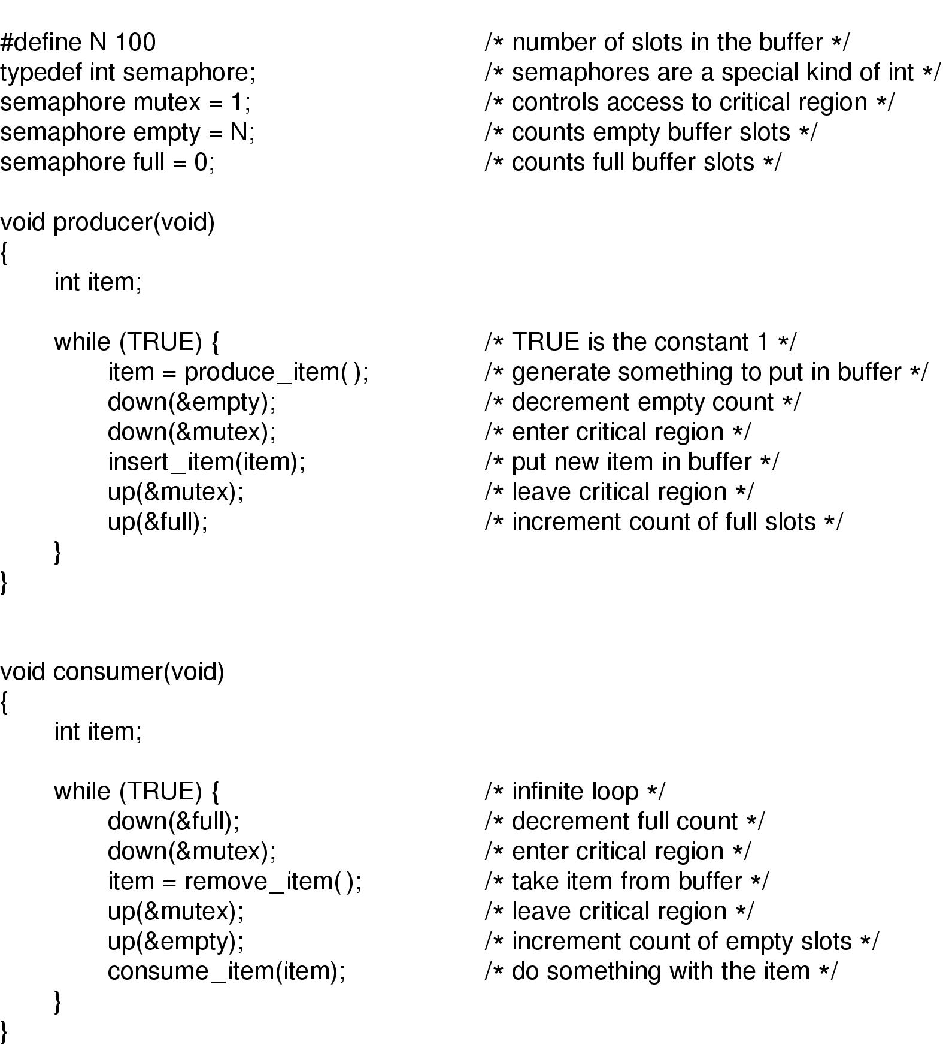
Using Semaphores in the Producer/Consumer Problem
EMPTY - # of empty slots.
FULL - # of full slots.
MUTEX – Prevents simultaneous access to the buffer.

Slide 31
Mutual Exclusion with Semaphores
When a semaphore’s counting ability is not needed, we can use a simplified version called a “mutex”.
1 = Unlocked.
0 = Locked.
Two processes can then attempt do DOWN the semaphore.
Only one will succeed. The other will block.
When the successful process exits the critical section, it does an UP, waking the other process up.

Slide 32
Mutual Exclusion with Semaphores
Process A
Process B
sema=1
…
non_critical_section()
DOWN(sema)
critical_section()
UP(sema)
…
non_critical_section()
DOWN(sema)
critical_section()
UP(sema)
…

Slide 33
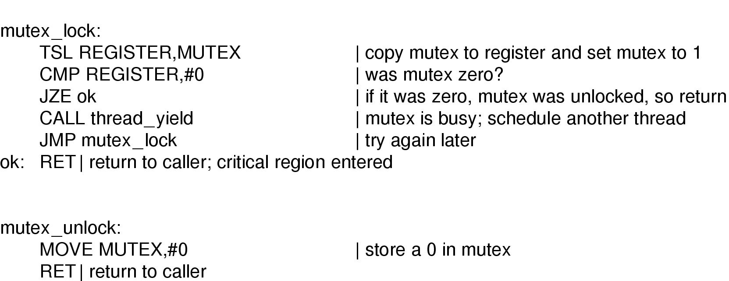
Mutual Exclusion with TSL/XCHG
We can also implement mutexes with TSL or XCHG.
0 = Unlocked, 1 = Locked.

Slide 34
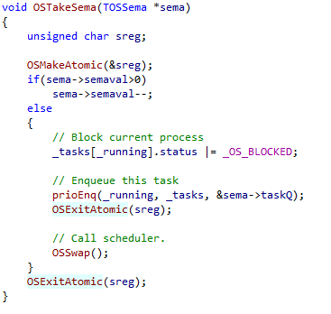
Semaphore Implementation in ArdOS
Taking a Semaphore:

Slide 35
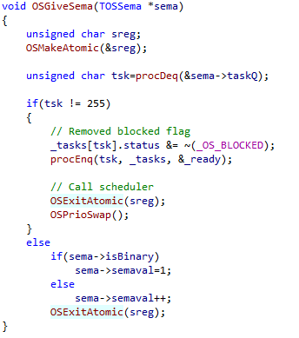
Semaphore Implementation in ArdOS
Giving a Semaphore

Slide 36
Deadlocks with semaphores
Inter-Process Communications

Slide 37

Problems with Semaphores Deadlock
Our producer/consumer solution has a problem:
If we swapped the semaphores for empty/full with the mutex semaphore, we have a potential deadlock:

Slide 38
Problems with Semaphores Deadlock
This can happen:
Producer successfully DOWNs the mutex.
Producer DOWNs “empty”. However the queue is full so this blocks.
Consumer DOWNs mutex and blocks.
Consumer now never reaches the UP for “empty” and therefore cannot unblock the producer.
The producer in turn never reaches the UP for mutex and cannot unblock the consumer.
Deadlock!

Slide 39
Deadlock Reusable/Consumable Resources
Reusable Resources
Examples: memory, devices, files, tables
Number of units is constant
Unit is either free or allocated; no sharing
Process requests, acquires, releases units
Consumable Resources
Examples: messages, signals
Number of units varies at runtime
Process releases (create) units (w/o acquire)
Other process requests and acquires (consumes)

Slide 40
Deadlock More Deadlock Examples
p1: ... p2: ...
open(f1,w); open(f2,w);
open(f2,w); open(f1,w);
... ...
Deadlock when executed concurrently
p1: if (C) send(p2,m); p2: ...
while(1) {... while(1) {...
recv(p2,m); recv(p1,m);
send(p2,m); send(p1,m);
... } ... }
Deadlock when C not true

Slide 41
Dealing with Deadlocks
Detection and Recovery
Allow deadlock to happen and eliminate it
Avoidance (dynamic)
Runtime checks disallow allocations that might lead to deadlocks
Prevention (static)
Restrict type of request and acquisition to make deadlock impossible

Slide 42
Deadlock Prevention
Deadlock requires the following 3 conditions:
Mutual exclusion:
Resources not sharable
Hold and wait:
Process must be holding one resource while requesting another
Circular wait:
At least 2 processes must be blocked on each other

Slide 43
Deadlock Prevention
Eliminate mutual exclusion
Not possible in most cases
Spooling makes I/O devices sharable
Eliminate hold-and-wait
Request all resources at once
Release all resources before a new request
Release all resources if current request blocks
Eliminate circular wait
Order all resources
Process must request in ascending order

Slide 44
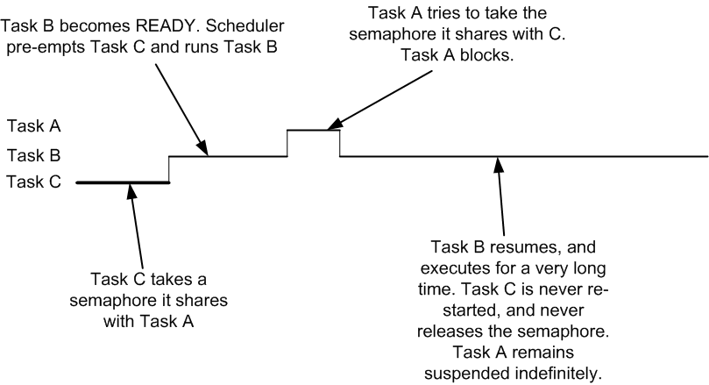
Problems with Semaphores Priority Inversion
In the diagram on the following page, priority(Process C) < priority(Process B) < priority(Process A).
Process B effectively blocks out Process A, although Process A has higher priority!

Slide 45
Monitors and conditional variables
Inter-Process Communications

Slide 46
Monitors
A monitor is similar to a class or abstract-data type in C++ or JAVA:
Collection of procedures, variables and data structures grouped together in a package.
Access to variables and data possible only through methods defined in the monitor.
However, only one process can be active in a monitor at any point in time.
I.e. if any other process tries to call a method within the monitor, it will block until the other process has exited the monitor.

Slide 47
Monitors
Implementation:
When a process calls a monitor method, the method first checks to see if any other process is already using it.
If so, the calling process blocks until the other process has exited the monitor.
This can be achieved using mutexes or binary semaphores.
The mutex/semaphore operations are inserted by the compiler itself rather than by the user, reducing the likelihood of errors.

Slide 48
Monitors and Condition Variables
Monitors achieve mutual exclusion, but we also need other mechanisms for coordination.
E.g. in our producer/consumer problem, mutual exclusion alone is not enough to prevent the producer from proceeding when the buffer is full.
We introduce “condition variables”.
One process WAITs on a condition variable and blocks, until..
Another process SIGNALs on the same condition variable, unblocking the WAITing process.

Slide 49
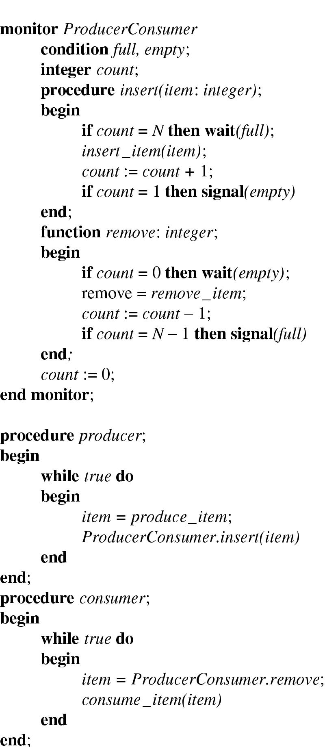
Monitors and Condition Variables
Implementing the Producer/Consumer problem with semaphores and condition variables:
When the buffer is full (count==N), producer will WAIT on a full condition.
When buffer is empty (count==0), consumer will WAIT on empty.

Slide 50
Monitors and Condition Variables
When a process encounters a WAIT, it is blocked and another process is allowed to enter the monitor.
Problem:
When there’s a SIGNAL, the sleeping process is woken up.
We will potentially now have two processes in the monitor at the same time:
The process doing the SIGNAL (the signaler).
The process that just woke up because of the SIGNAL (the signaled).

Slide 51
Monitors and Condition Variables
We have 3 ways to resolve this:
We require that the signaler exits immediately after calling SIGNAL.
We suspend the signaler immediately and resume the signaled process.
We suspend the signaled process until the signaler exits, and resume the signaled process only after that.

Slide 52
Monitors and Condition Variables
A condition variable is different from a semaphore.
Semaphore:
If Process A UPs a semaphore with no pending DOWN, the UP is saved.
The next DOWN operation will not block because it will match immediately with a preceding UP.
Condition variable:
If Process A SIGNALs a condition variable with no pending WAIT, the SIGNAL is simply lost.
This is similar to the SLEEP/WAKE problem earlier on.

Slide 53
Monitors and Condition Variables
This code looks suspiciously like our original producer/consumer problem on Page 23!
Same issues too:
Page 23:
Consumer sees count==0, and intends to SLEEP but gets pre-empted.
Producer sends a WAKE but the WAKE is lost.
In this case, if the consumer gets pre-empted before a WAIT, the corresponding SIGNAL from the producer is also lost!
However we see that in this case, the mutual exclusion from the monitor prevents the SIGNAL from being lost! (WHY?)

Slide 54
barriers
Inter-Process Communications

Slide 55
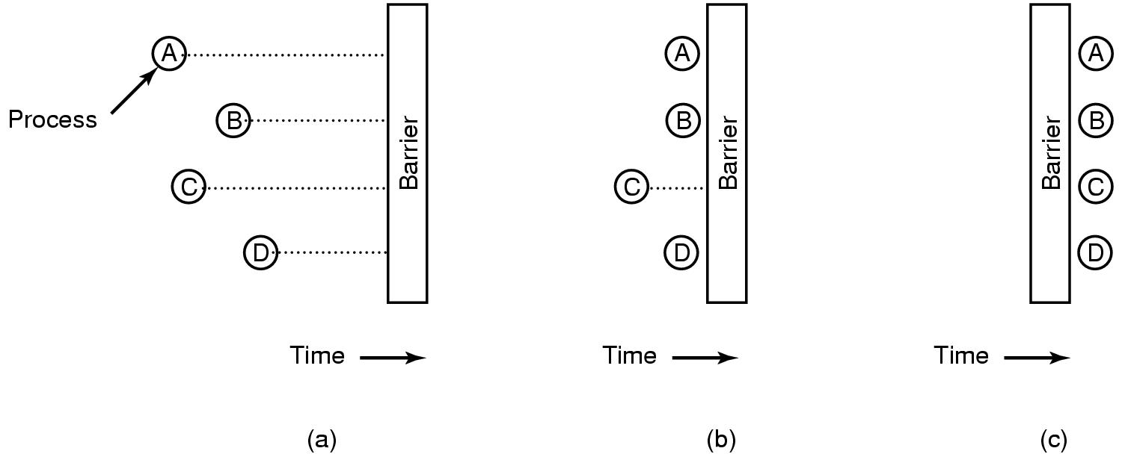
Barriers
A “barrier” is a special form of synchronization mechanism that works with groups of processes rather than single processes.

Slide 56
Barriers
The idea of a barrier is that all processes must reach the barrier (signifying the end of one phase of computation) before any of them are allowed to proceed.
Process D reaches the end of the current phase and calls a BARRIER primitive in the OS. It gets blocked.
Similarly processes A and B reach the end of the current phase, calls the same BARRIER primitive and is blocked.
Finally process C reaches the end of its computation, calls the BARRIER primitive, causing all processes to be unblocked at the same time.

Slide 57
Barriers
Example barrier application.
Computing fluid motion across a surface represented by a 1,000,000 x 1,000,000 matrix.
The complete matrix for iteration N must be available before computing for iteration N+1.
1,000 individual processes each computing a part of the entire matrix.
We must wait for all 1,000 processes to complete finding the entire matrix before we can start on the next iteration.
A barrier would be very useful in achieving this.

